Slide 1
Multimedia System and Virtual Environment
CSE – 310
Lecture 6
Audio
Dept. of Computer Science and Engineering, University of Rajshahi

Slide 2
Audio
Lecture 6
What is sound?
Capture and playback of digital audio
Pulse Code Modulation (PCM) technique.
Nyquist Theorem
Quantization
SNR and SQNR
PCM Decoder
Dept. of Computer Science and Engineering, University of Rajshahi

Slide 3
Audio
Lecture 6
What is sound?
Sound comprises the spoken word, voices, music and even noise.
It is a complex relationship involving a vibrating object (sound source), a transmission medium (usually air), a receiver (ear) and a perceptor (brain). Example banging drum.
As the sound vibrates it bumps into molecules of the surrounding medium causing pressure waves to travel away from the source in all directions
So, sound are rapid vibrations that are transmitted as variations in air pressure.
Dept. of Computer Science and Engineering, University of Rajshahi

Slide 4
Audio
Lecture 6
Waveforms
Sound waves are manifest as waveforms
A waveform that repeats itself at regular intervals is called a periodic waveform
Waveforms that do not exhibit regularity are called noise
The unit of regularity is called a cycle
This is known as Hertz (or Hz) after Heinrich Hertz
One cycle = 1 Hz
Sometimes written as kHz or kiloHertz (1 kHz = 1000 Hz)
Time for one cycle
distance
Cycle
along wave
Dept. of Computer Science and Engineering, University of Rajshahi

Slide 5
Audio
Lecture 6
The characteristics of sound waves
Sound is described in terms of two characteristics:
Frequency
Amplitude (or loudness)
Frequency
The rate at which sound is measured
Number of cycles per second or Hertz (Hz)
Determines the pitch of the sound as heard by our ears
The higher frequency, the clearer and sharper the sound
Dept. of Computer Science and Engineering, University of Rajshahi

Slide 6
Audio
Lecture 6
The characteristics of sound waves
Amplitude
Sound’s intensity or loudness
The louder the sound, the larger amplitude.
In addition, all sounds have a duration and successive musical sounds is called rhythm
Amplitude
Time for one cycle
pitch
distance
along wave
Cycle
Dept. of Computer Science and Engineering, University of Rajshahi

Slide 7
Audio
Lecture 6
Capture and playback of digital audio
Air pressure
variations
Digital to
Analogue
Converter
Converts back into voltage
DAC
Captured via
microphone
Signal is
converted into
binary (discrete form)
0101001101
0110101111
Analogue
to Digital
Converter
ADC
Dept. of Computer Science and Engineering, University of Rajshahi

Slide 8
Audio
Lecture 6
The Analog to Digital Converter (ADC)
An ADC is a device that converts analogue signals into digital signals
An analog signal is a continuous value
It can have any single value on an infinite scale
A digital signal is a discrete value
It has a finite value (usually an integer)
An ADC is synchronised to some clock
It will monitor the continuous analog signal at a set rate and convert into a discrete value at that specific moment in time
Dept. of Computer Science and Engineering, University of Rajshahi

Slide 9
Audio
Lecture 6
ANALOG-TO-DIGITAL CONVERSION
A digital signal is superior to an analog signal because it is more robust to noise and can easily be recovered, corrected and amplified. For this reason, the tendency today is to change an analog signal to digital data. In this section we describe-
Pulse Code Modulation (PCM) technique.
Dept. of Computer Science and Engineering, University of Rajshahi

Slide 10
Audio
Lecture 6
PCM
PCM consists of three steps to digitize an analog signal:
Sampling
Quantization
Binary encoding
Before we sample, we have to filter the signal to limit the maximum frequency of the signal as it affects the sampling rate.
Filtering should ensure that we do not distort the signal, i.e., remove high frequency components that affect the signal shape.
Dept. of Computer Science and Engineering, University of Rajshahi

Slide 11
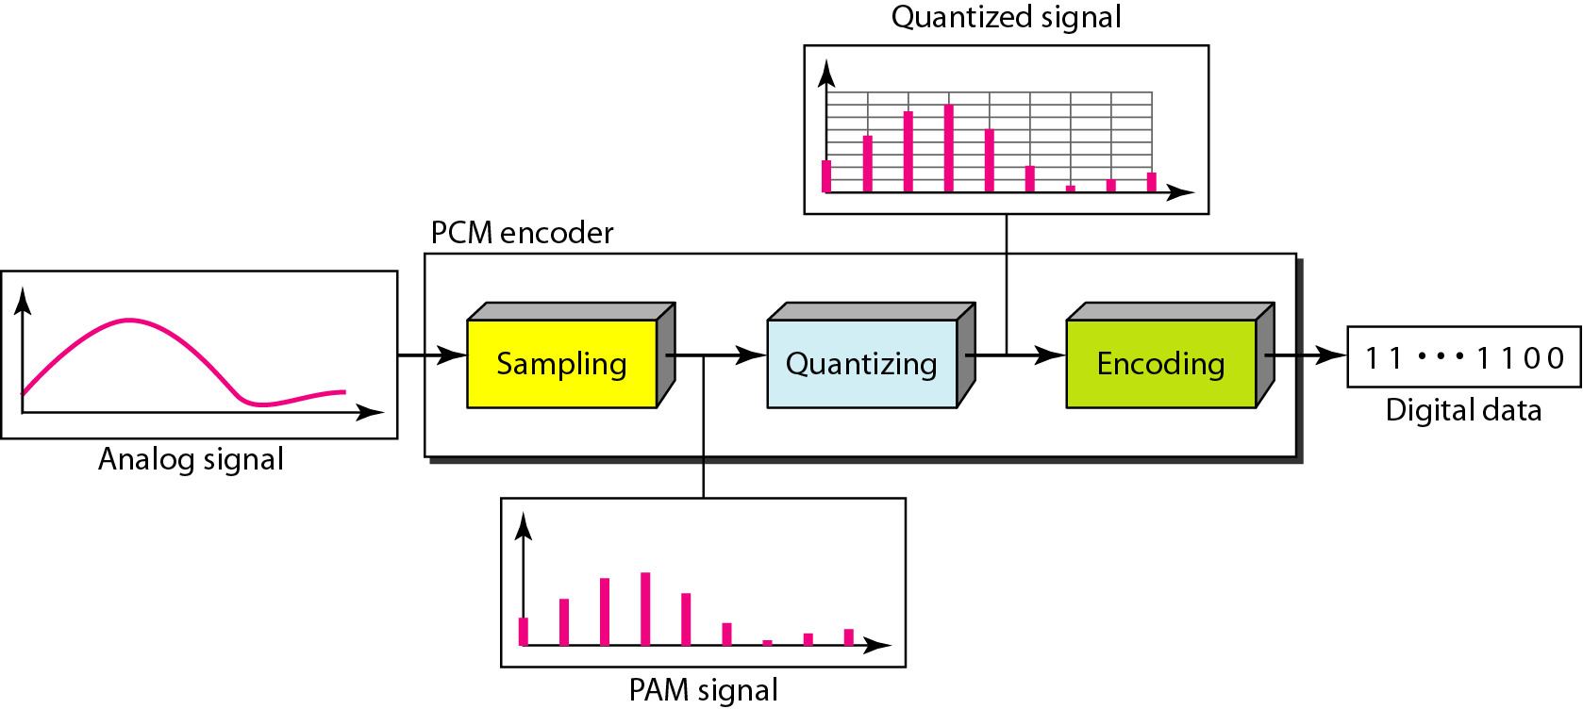
Audio
Lecture 6
Components of PCM encoder
Dept. of Computer Science and Engineering, University of Rajshahi

Slide 12
Audio
Lecture 6
Sampling
Analog signal is sampled every T_{S} secs.
T_{s} is referred to as the sampling interval.
f_{s} = 1/T_{s} is called the sampling rate or sampling frequency.
The process is referred to as pulse amplitude modulation (PAM) and the outcome is a signal with analog (non integer) values
Dept. of Computer Science and Engineering, University of Rajshahi

Slide 13
Audio
Lecture 6
Sampling
Two parameters:
Sampling Rate
The higher sampling rate, higher quality sound but size storage is big.
Standard Sampling rate:
- 44.1 KHz for CD Audio
- 11.025 KHz for spoken
- 5.1025 KHz for audio effect
Size sample
The resolution of a sample is the number of bits it uses to store a given amplitude value, e.g.
8 bits (256 different values)
16 bits (65536 different values)
A higher resolution will give higher quality
Dept. of Computer Science and Engineering, University of Rajshahi

Slide 14


Audio
Lecture 6
Nyquist Theorem
According to the Nyquist theorem, the sampling rate must be at least 2 times the highest frequency contained in the signal.
Dept. of Computer Science and Engineering, University of Rajshahi

Slide 15
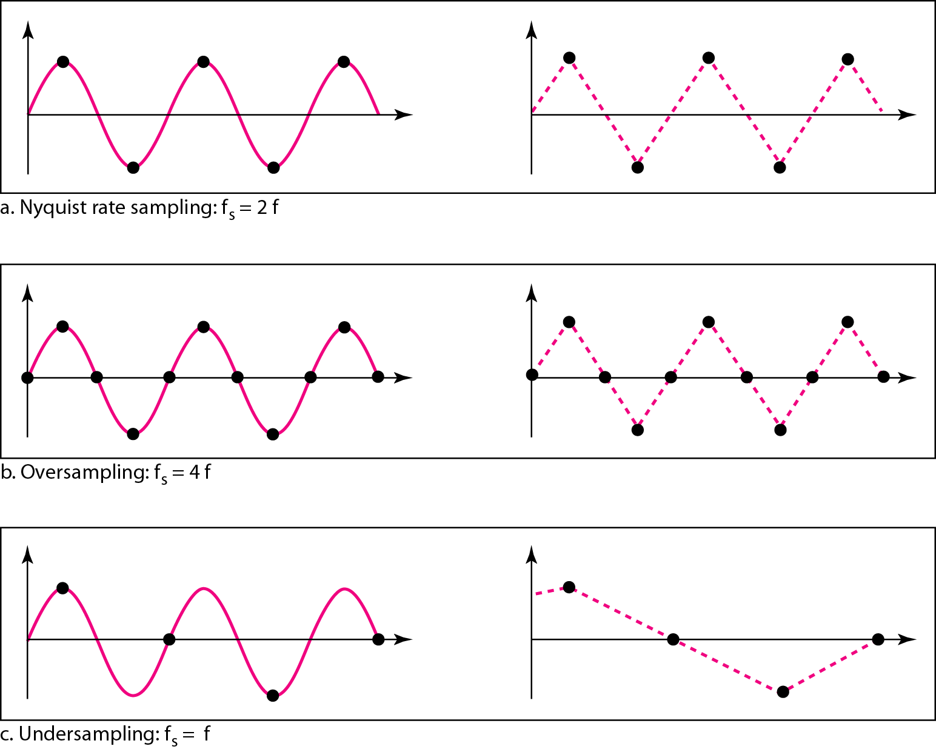
Audio
Lecture 6
Recovery of a sampled sine wave for different sampling rates
Dept. of Computer Science and Engineering, University of Rajshahi

Slide 16
Audio
Lecture 6
Nyquist Theorem
It can be seen that sampling at the Nyquist rate can create a good approximation of the original sine wave.
Oversampling in can also create the same approximation, but it is redundant and unnecessary.
Sampling below the Nyquist rate does not produce a signal that looks like the original sine wave.
Dept. of Computer Science and Engineering, University of Rajshahi

Slide 17
Audio
Lecture 6
Prob: Telephone companies digitize voice by assuming a maximum frequency of 4000 Hz. What is the sampling rate for this signal?
Solution
The sampling rate therefore is 8000 samples per second.
Prob: A complex low-pass signal has a bandwidth of 200 kHz. What is the minimum sampling rate for this signal?
Solution
The bandwidth of a low-pass signal is between 0 and f, where f is the maximum frequency in the signal. Therefore, we can sample this signal at 2 times the highest frequency (200 kHz). The sampling rate is therefore 400,000 samples per second.
Dept. of Computer Science and Engineering, University of Rajshahi

Slide 18
Audio
Lecture 6
Quantization
Samples are usually represented the audio sample as a integers or digital
Dept. of Computer Science and Engineering, University of Rajshahi

Slide 19
Audio
Lecture 6
Quantization
Sampling results in a series of pulses of varying amplitude values ranging between two limits: a min and a max.
The amplitude values are infinite between the two limits.
We need to map the infinite amplitude values onto a finite set of known values.
This is achieved by dividing the distance between min and max into L zones, each of height Δ.
Δ = (max - min)/L
Dept. of Computer Science and Engineering, University of Rajshahi

Slide 20
Audio
Lecture 6
Quantization Levels
The midpoint of each zone is assigned a value from 0 to L-1 (resulting in L values)
Each sample falling in a zone is then approximated to the value of the midpoint.
Quantization Zones
Assume we have a voltage signal with amplitutes V_{min}=-20V and V_{max}= +20V.
We want to use L = 8 quantization levels.
Zone width Δ = (20 +20)/8 = 5
The 8 zones are: -20 to -15, -15 to -10, -10 to -5, -5 to 0, 0 to +5, +5 to +10, +10 to +15, +15 to +20
The midpoints are: -17.5, -12.5, -7.5, -2.5, 2.5, 7.5, 12.5, 17.5
Dept. of Computer Science and Engineering, University of Rajshahi

Slide 21
Audio
Lecture 6
Assigning Codes to Zones
Each zone is then assigned a binary code.
The number of bits required to encode the zones, or the number of bits per sample as it is commonly referred to, is obtained as follows:
n_{b} = log₂ L
Given our example, n_{b} = 3
The 8 zone (or level) codes are therefore: 000, 001, 010, 011, 100, 101, 110, and 111
Assigning codes to zones:
000 will refer to zone -20 to -15
001 to zone -15 to -10, etc.
Dept. of Computer Science and Engineering, University of Rajshahi

Slide 22
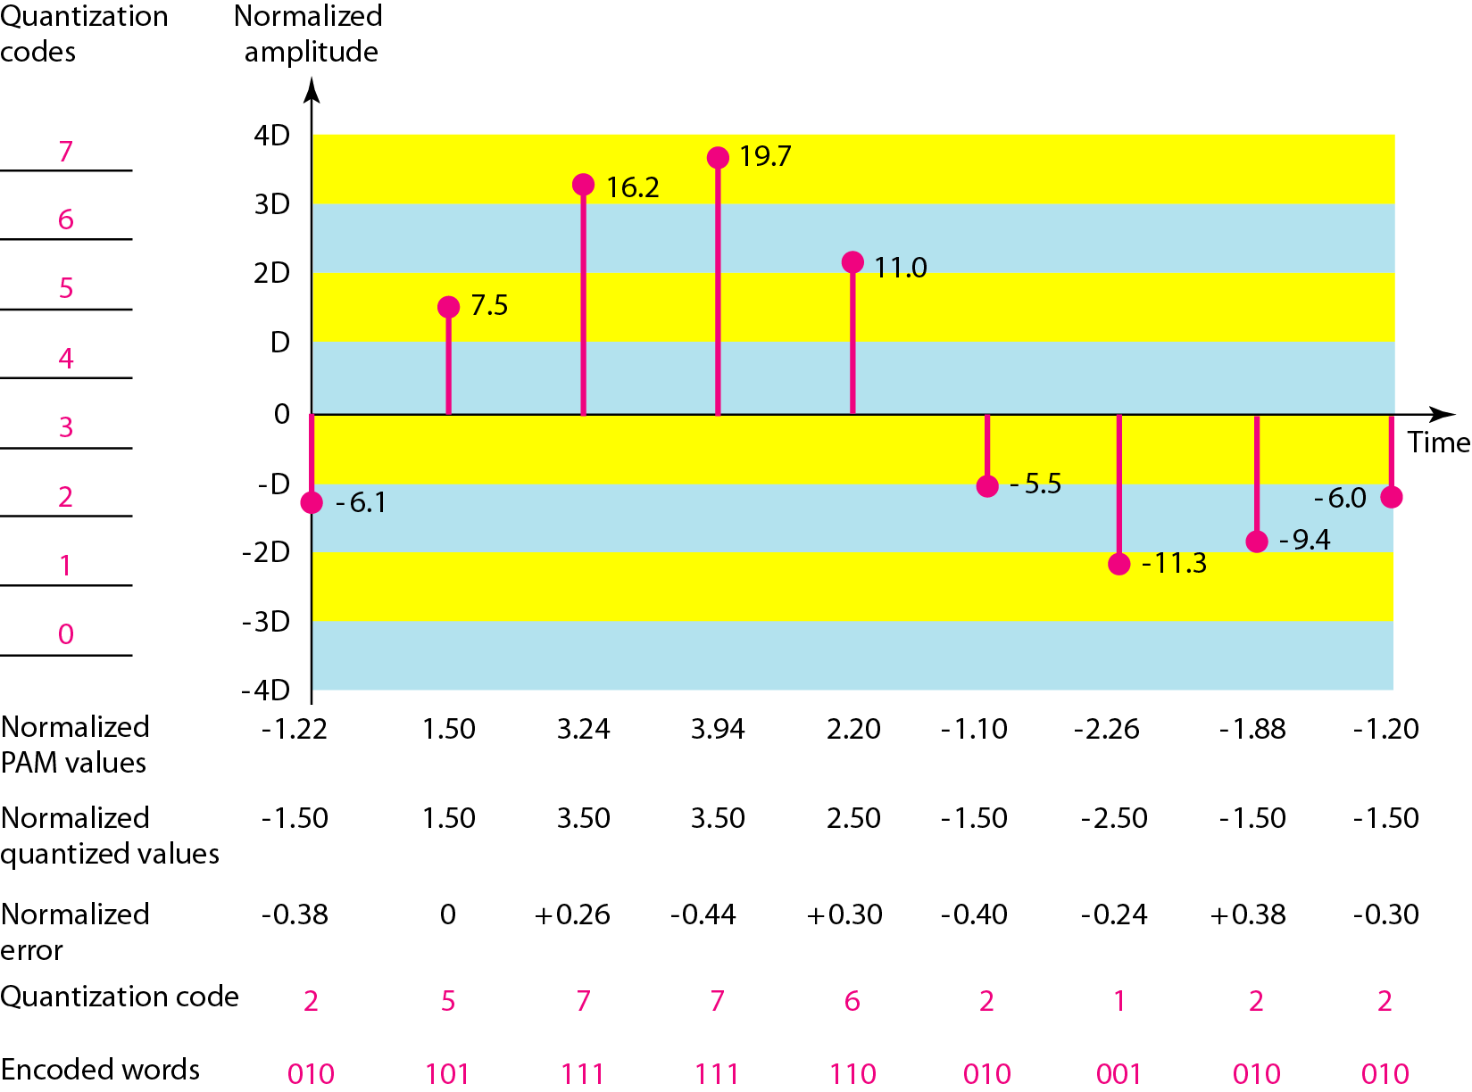
Audio
Lecture 6
Quantization and encoding of a sampled signal
Dept. of Computer Science and Engineering, University of Rajshahi

Slide 23
Audio
Lecture 6
Quantization Error
When a signal is quantized, we introduce an error - the coded signal is an approximation of the actual amplitude value.
The difference between actual and coded value (midpoint) is referred to as the quantization error.
The more zones, the smaller Δ which results in smaller errors.
BUT, the more zones the more bits required to encode the samples -> higher bit rate
Dept. of Computer Science and Engineering, University of Rajshahi

Slide 24
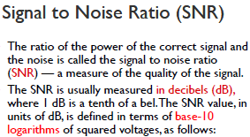


Audio
Lecture 6
Dept. of Computer Science and Engineering, University of Rajshahi

Slide 25
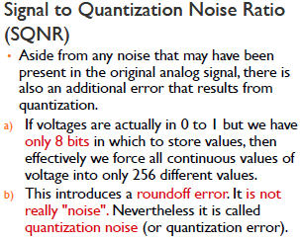
Audio
Lecture 6
Dept. of Computer Science and Engineering, University of Rajshahi

Slide 26
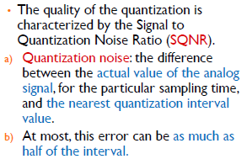
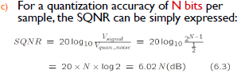
Audio
Lecture 6
Dept. of Computer Science and Engineering, University of Rajshahi

Slide 27
Audio
Lecture 6
PCM Decoder
To recover an analog signal from a digitized signal we follow the following steps:
We use a hold circuit that holds the amplitude value of a pulse till the next pulse arrives.
We pass this signal through a low pass filter with a cutoff frequency that is equal to the highest frequency in the pre-sampled signal.
The higher the value of L, the less distorted a signal is recovered.
Dept. of Computer Science and Engineering, University of Rajshahi

Slide 28
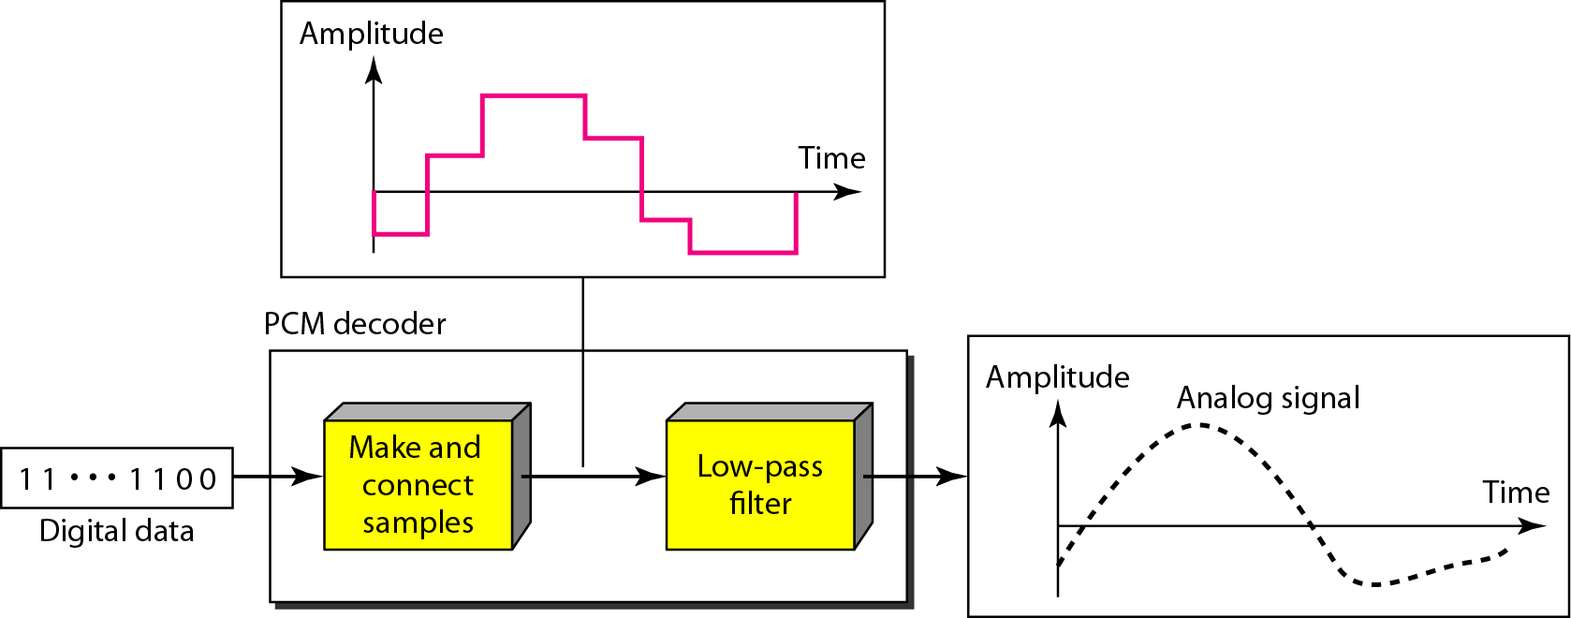
Audio
Lecture 6
Components of a PCM decoder
Dept. of Computer Science and Engineering, University of Rajshahi

Slide 29
Audio
Lecture 6
Calculating the size of digital audio
The formula is as follows:
The answer will be in bytes
Where:
sampling rate is in Hz
Duration/time is in seconds
resolution is in bits (1 for 8 bits, 2 for 16 bits)
number of channels = 1 for mono, 2 for stereo, etc.
Dept. of Computer Science and Engineering, University of Rajshahi

Slide 30
Audio
Lecture 6
Calculating the size of digital audio
Prob: Calculate the file size for 1 minute, 44.1 KHz (CD Quality), 16 bits, stereo sound
Where:
sampling rate is 44,100 Hz
Duration/time is 60 seconds
resolution is 16 bits
number of channels for stereo is 2
44100 * 60 * 16 *2
8
Dept. of Computer Science and Engineering, University of Rajshahi

